Slide 1
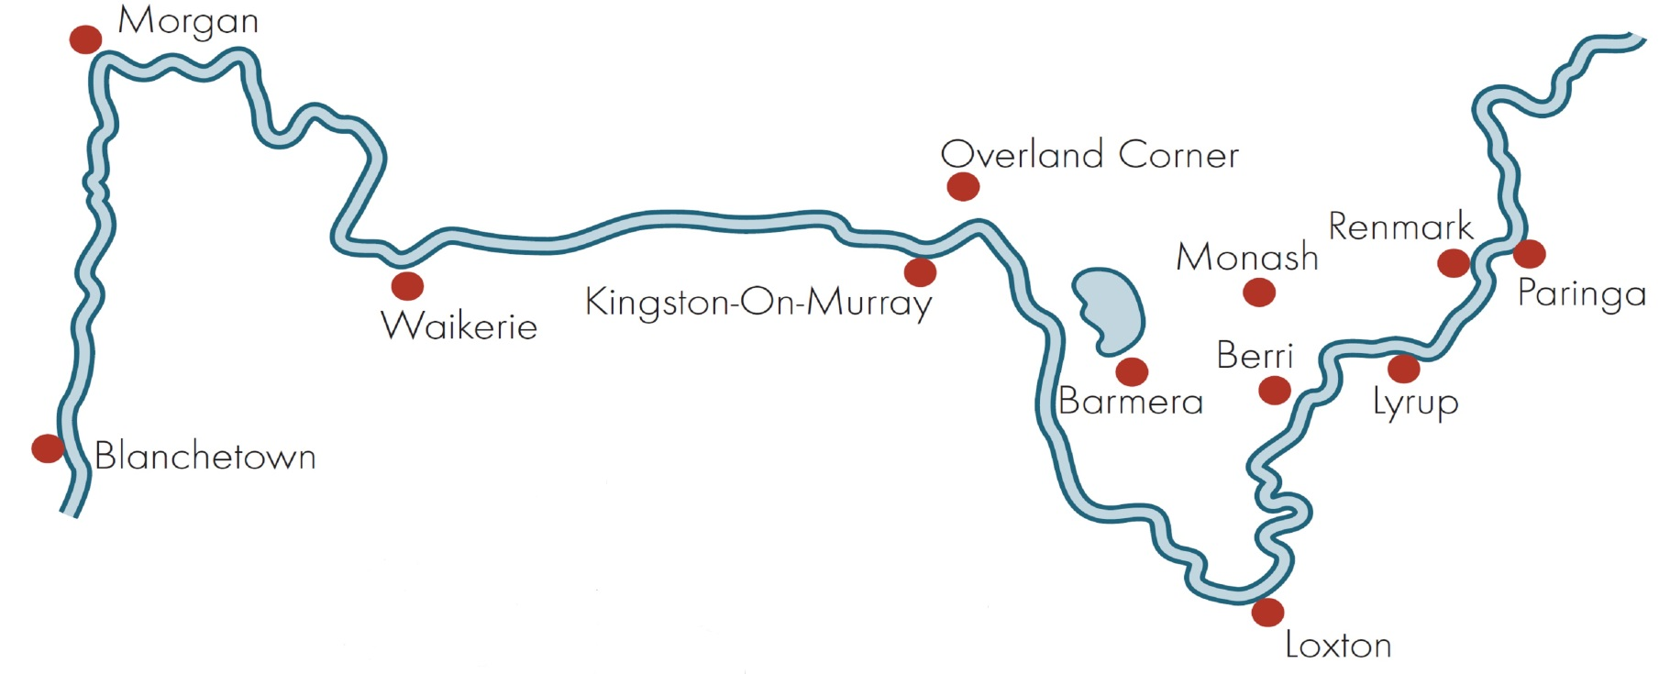

Riverland Wine Industry Forum
Chaffey Theatre Renmark
Wednesday 15 October 2014

Slide 2
Jim Moularadellis
Chief Enthusiasm Officer
Austwine
Wine Exporters and Brokers
Chaffey Theatre Renmark
Wednesday 15 October 2014

Slide 3
3 Key Points Today
Vintage 2014 - Recap
  Why did Grape Prices fall?
  Grape Price to Bulk Wine Price Formula
Vintage 2015 - Outlook
  Sales Trends: Domestic, Imports & Exports
Long Term Outlook
  The Road Ahead

Slide 4
Vintage 2014
A Quick Recap
Notes:
2014 conditions were a bit stormy !

Slide 5
Vintage 2014
WFA Estimate Crush of ~1.7mT
Bang on the 7-year average.
Graphically…

Slide 6
2014 Crush

Slide 7
2014 Crush
So if the 2014 crush was about average, why did grape prices fall?

Slide 8
2013 Inventory was up

Slide 9
2013 Bulk Wine Prices were Down
…….So what is the relationship between bulk wine prices and grape prices?
They follow each other closely.
But bulk wine prices are more volatile than grape prices, as the following 2 charts illustrate…

Slide 12
Grape Price to Bulk Wine Price Formula
When Demand = Supply :
Bulk Price = Grape Price/750 + 50c
But if bulk wine prices are more volatile than grape prices, how does the formula work?

Slide 13
Grape Price to Bulk Wine Price Formula
When Demand > Supply :
50c

Slide 14
Grape Price to Bulk Wine Price Formula
When Supply > Demand :
50c

Slide 15
Grape Price to Bulk Wine Price Formula
This is the critical pricing signal that wineries use to estimate grape prices the following year.
And this is based on the prevailing bulk wine price in December, when grape prices start being set.

Slide 16
Grape Price to Bulk Wine Price Formula
So, some bulk wine price examples from 2013.
To explain what happened to grape prices in 2014.
And what to expect in 2015…

Slide 17
Grape Price to Bulk Wine Price Formula
Remember….
When Demand = Supply :
Bulk Price = Grape Price/750 + 50c

Slide 18
Chardonnay Pricing
Using the above formula, if CHA is $300/t, which it was in 2013, this is 40c as grapes + 50c to turn it into bulk.
Bulk wine price SHOULD have been 90cpl.
But in 2013 there was way too much CHA. Bulk prices started at 80cpl and ended at 60cpl, even 50cpl. Wineries were making big losses.
So 2014 CHA grape prices fell to a bit over $200. Enough to cover bulk sales at 80cpl, but not at 60cpl.
For 2015, using the formula, CHA prices might fall a bit in 2015, but not by much.

Slide 19
Chardonnay Pricing
Let’s look at it another way:
Today, the CHA bulk price is 75cpl, and stable.
So this translates to a grape price of a bit under $200/t for 2015.
In 2014, CHA grapes average a bit over $200, so for 2015 CHA prices might fall a bit, but not by much.
The formula checks out for CHA.
What about for reds?

Slide 20
Shiraz & Cabernet Pricing
If SHZ & CAB price is $400/t, which it was in 2013, that is ~55c as grapes + 50c to turn it into bulk.
Bulk wine price SHOULD be 105cpl.
But in 2013 SHZ & CAB bulk started at 110cpl and ended at 90cpl, some even at 80cpl. Wineries were making big losses again.
So 2014 SHZ & CAB grape prices fell to about $350. Enough for a bulk sales price of 100cpl, but not at 90cpl or 80cpl.
So SHZ & CAB prices might fall quite a bit in 2015.

Slide 21
Shiraz & Cabernet Pricing
Let’s check our logic another way:
Today, the bulk price for SHZ & CAB is 90cpl and going down. There is too much around.
By December it could easily be 85cpl.
So this translates to a grape price of a bit over $250/t, possibly less.
So SHZ & CAB prices might fall quite a bit in 2015.
Again, the formula checks out whichever way it is used.

Slide 22
One final thing…
Not all grape prices are equal !
Remember you get paid by the TONNE, but your expenses are incurred by the HECTARE.
Some wineries cap yields, others do not. This has big ramifications for you. For example…
$200/t CHA capped at 20t/Ha = $4,000 per Ha = Horrible
$200/t CHA uncapped at 30t/Ha = $6,000 per Ha = Less Horrible.
This equals $300/t capped at 20t/Ha
So check your grape price schedules carefully for caps !

Slide 23
Vintage 2015 Outlook
- Sales Trends

Slide 24
Domestic Sales of Australian Wine
Have been relatively static over the past few years, after 20 years of steady growth.
No major demand stimulus on horizon.
Graphically…

Slide 25
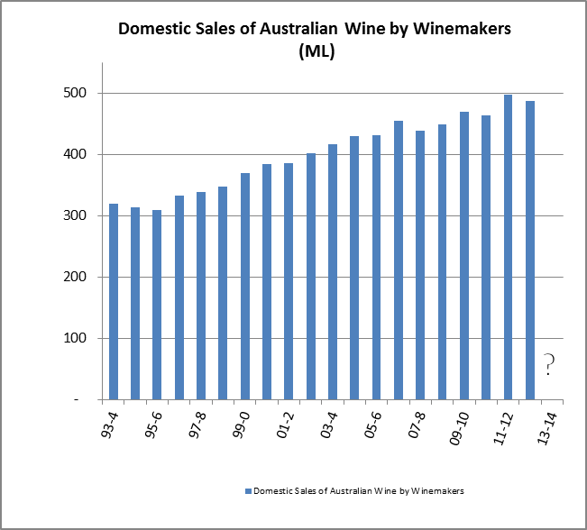
Domestic Sales

Slide 26
Imports
Imports have been booming,for almost a decade!
Mainly due to boom in Marlborough Sauvignon Blanc.
Imports are now about 15% of domestic volume.
The good news is that imports have stabilised in recent years. Graphically…

Slide 27
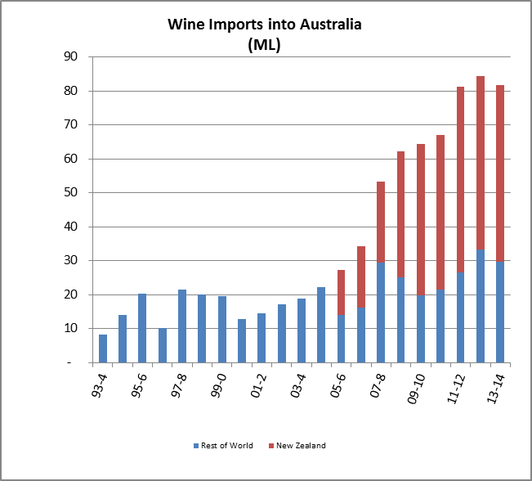
Imports

Slide 28
Imports
How much is 15% of domestic volume?
1 in 6 bottles
80m Litres.
Half of Berri Estate’s annual crush, or
All of Kingston Estate’s annual crush, or
2 x TWG Loxton’s annual crush.
4,500 Hectares of Riverland wine grapes at 25t/Ha
100% of SA Riverland Chardonnay plantings.
That is a lot wine !
At 15% volume share, imports are here to stay.

Slide 29
Exports
Have been falling for much of the last decade.
Why?
Easy answer: Persistently high A$ (until very recently.)
But its probably more complicated than that….

Slide 30
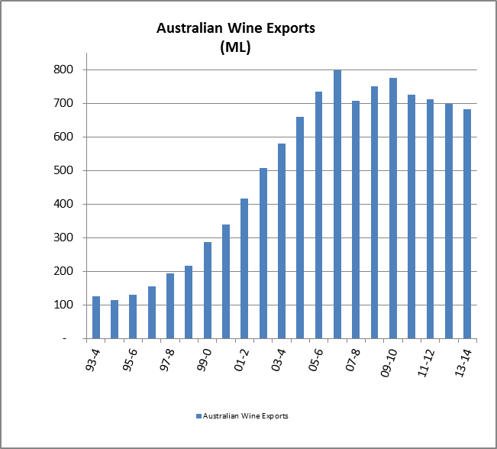
Exports

Slide 31
Demand Summary
Demand Volume =
Domestic static
+ Exports declining
- Import boom slowing
= Stormy weather ahead for Aussie vineyards, pictorially…

Slide 32
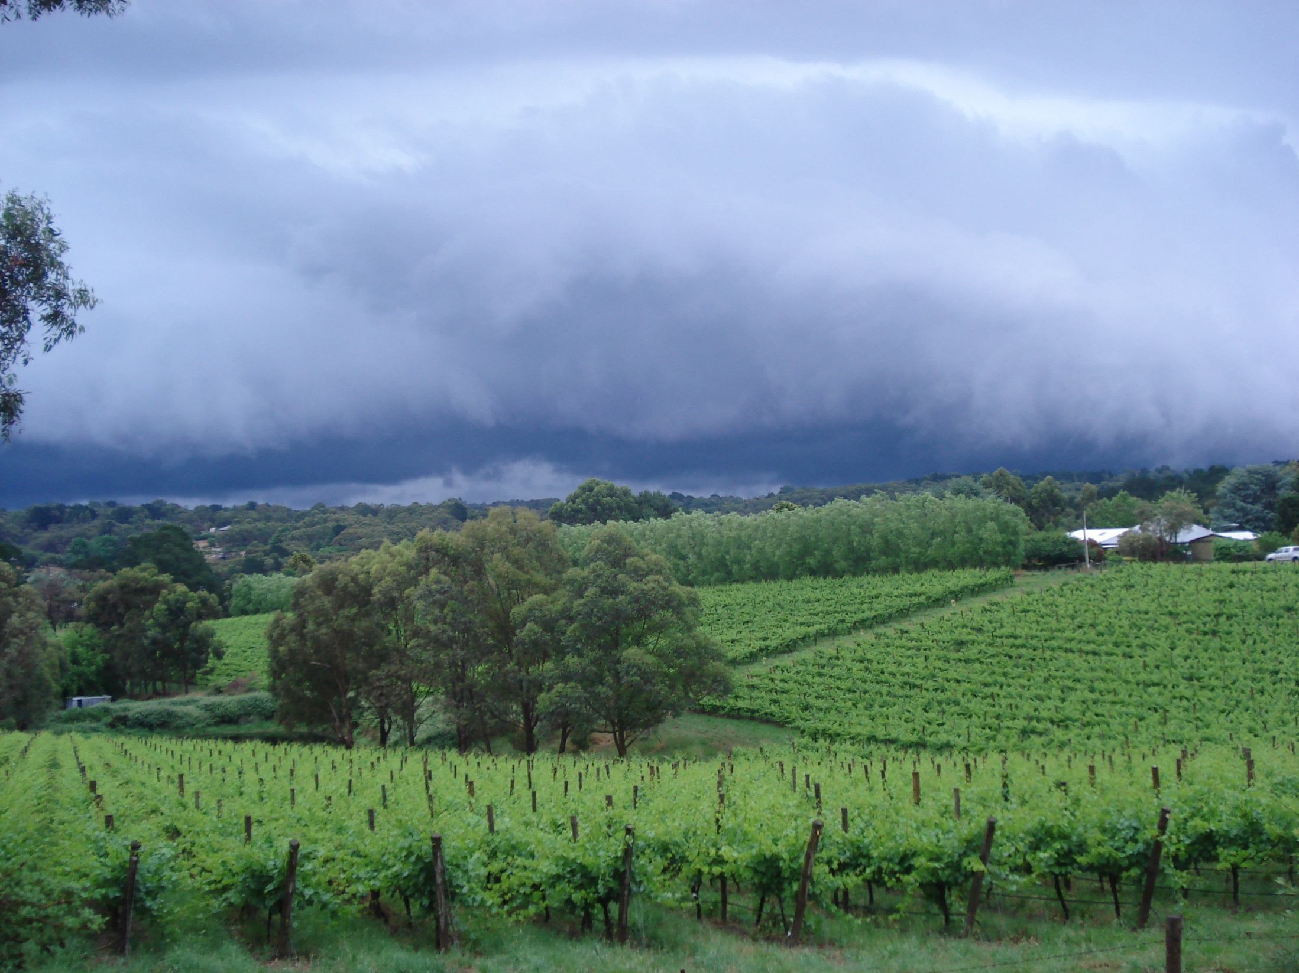

Slide 33
Long Term Outlook
Australia has been successfully exporting wine for > 150 years. Why?
Our wines are excellent.
Our climate is fitting.
Our resources accessible.
Our production assets world class.
Our intellectual property second to none.
Our legal and political systems are very stable.

Slide 34
Long Term Outlook
We can and we will translate more & more of our wonderful assets into market opportunities.
This is happening in many parts of the industry.
Mostly by long term players.
With long term agendas.
Supported by long term thinking.
So what does the road ahead look like?

Slide 35
The Road Ahead
It won’t be a perfect road.
We will only be able to see a little way ahead & much will be over the horizon.
There are some clouds on the horizon.
There are some parched paddocks.
But blue sky still exists.
We have many possible roads to take, many of them can lead us to renewed prosperity.
Pictorially….

Slide 36


Slide 37
Riverland Wine Industry Forum
Chaffey Theatre Renmark
Wednesday 15 October 2014

